Slide 2
Activities
Filter Design
Component Selection (Choke, Capacitors)
Two mode Designing (both is AWR and Hardware simulation(PCB))
S parameter measurement
Identify filter responses (frequency and time)
Compare responses (both is software and Hardware simulation)
Identify filter responses using both single and multi tone sources
Generate noise sources (both in Hardware and AWR)
Simulate the filter with noise source (both in AWR and Lab)

Slide 3
Filter Design
EMI filter is designed to reduce high frequency electronic noise that cause interference with other devices where considering the conducted emission produced by the components inside.
EMI filter is generally a superposition of CM and DM filter.
We have designed the filter work like a low pass filter.
Transmission loss and Insertion loss was measured.

Slide 4
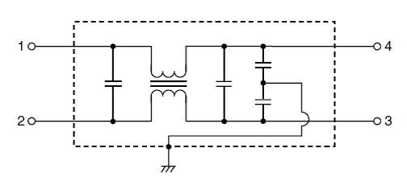
Component Selection (Choke, Capacitors)
Consists of passive components, including capacitors and inductors. A common mode choke is used instead of inductors which itself works like a filter. A CM CHOKE (744272102 - Würth Elektronik) is considered in the experiment. EMI filter uses capacitors to bypass unwanted high frequency noise from the circuits.

Slide 5
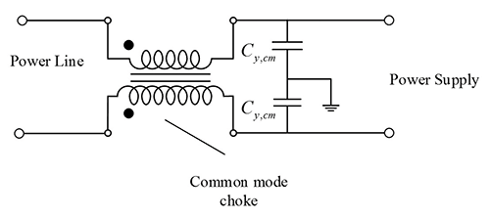
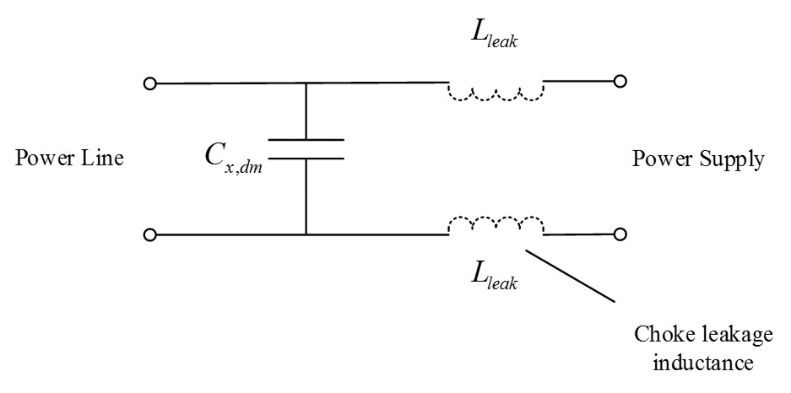
Conducted Emission Measurement
Measurements devided into CM noise and DM noise.
CMN:
CMN current flows in the same direction and returns via the ground.
CMN can be suppressed by the CM CHOKE and Y-capacitors.
DMN
DMN current flows along the line and returns along the neutral.
DMN can be suppressed using X-capacitors

Slide 6
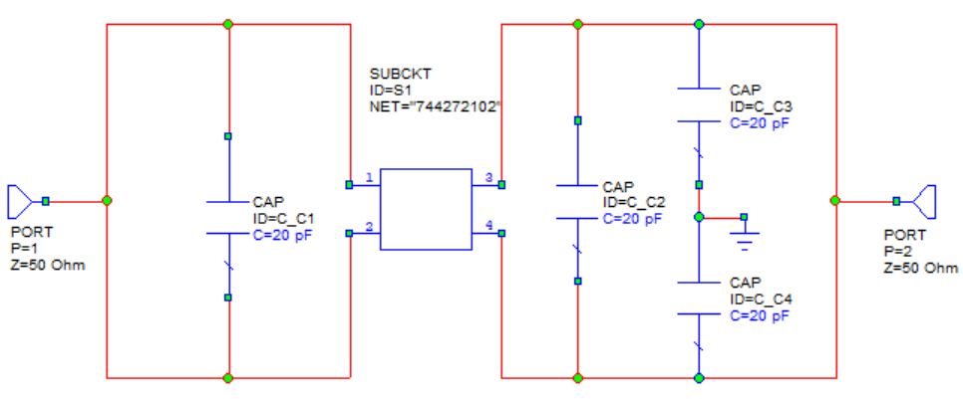
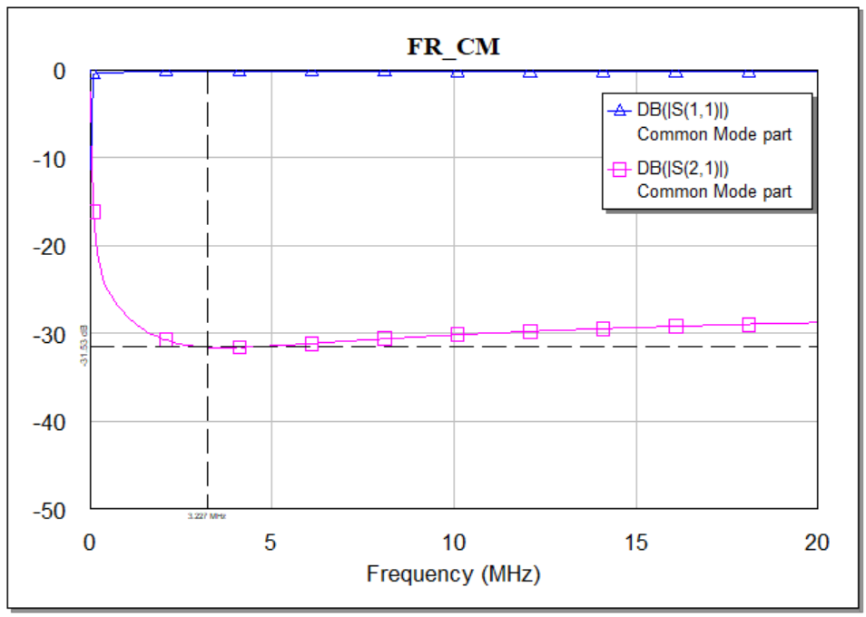
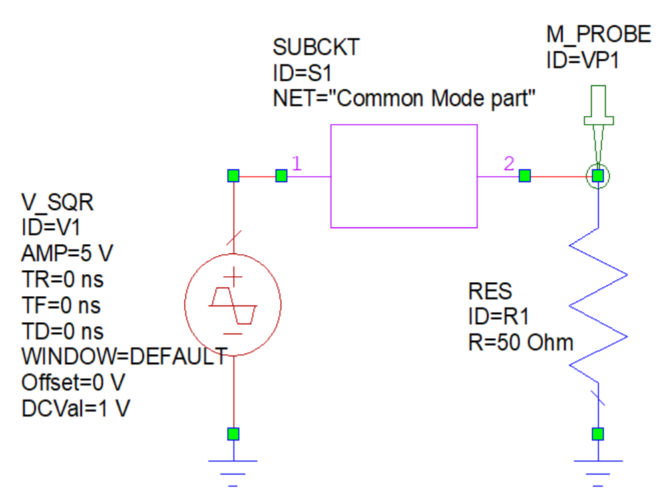
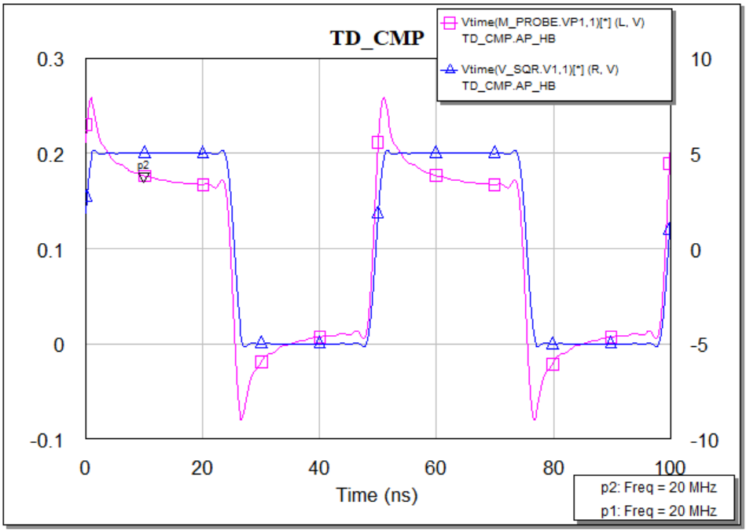
CM filter Design and measured responses

Slide 7
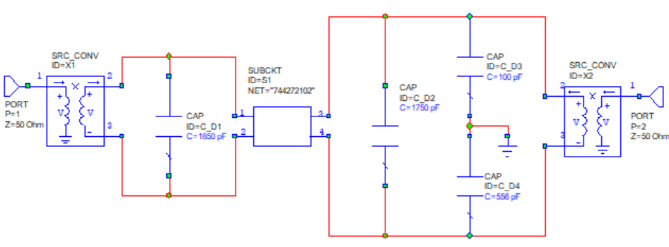
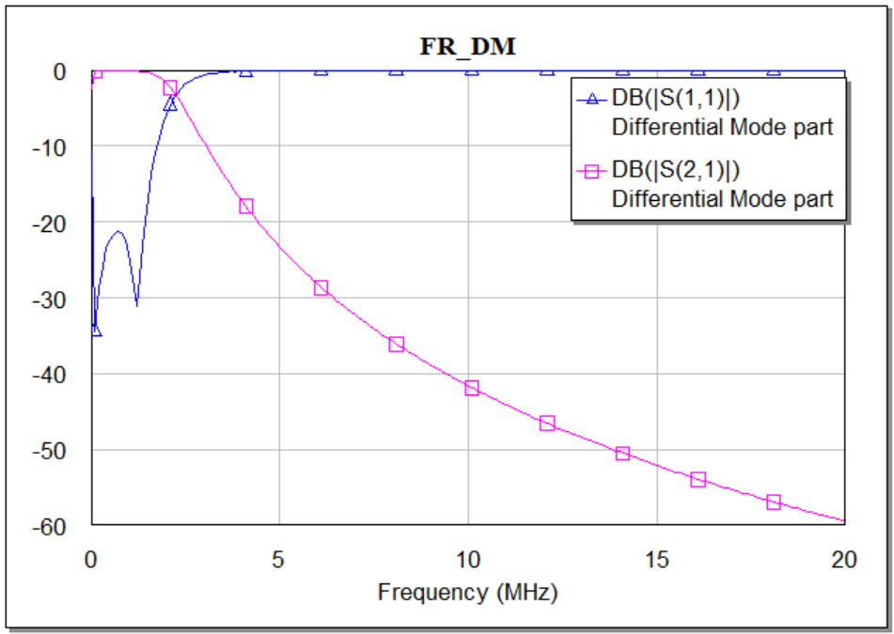
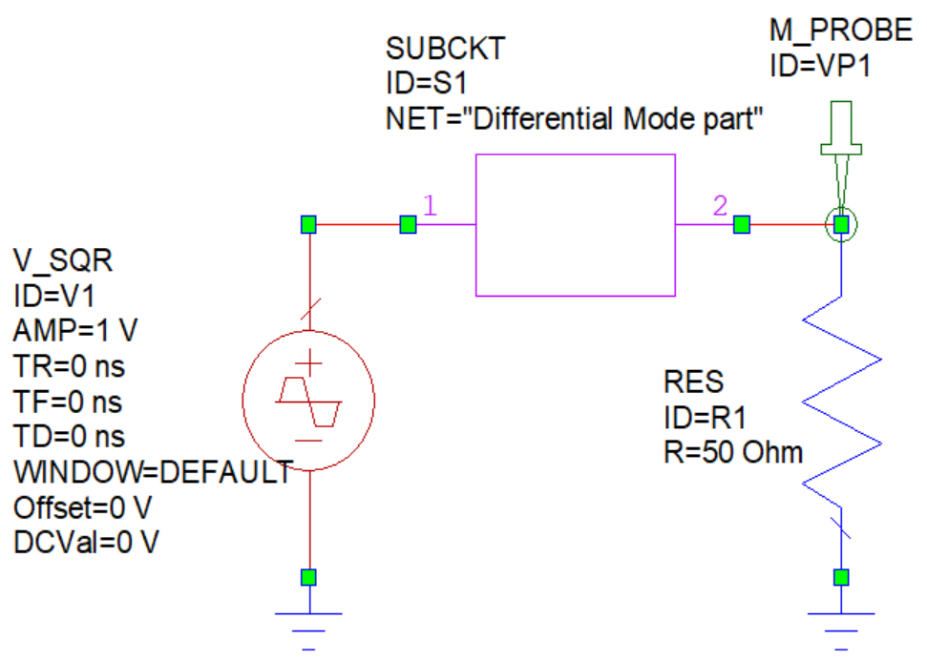
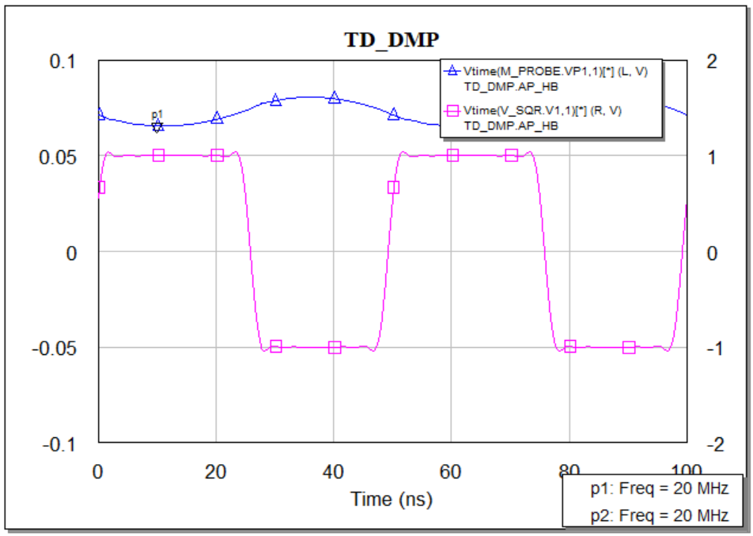
DM filter Design and measured responses

Slide 8
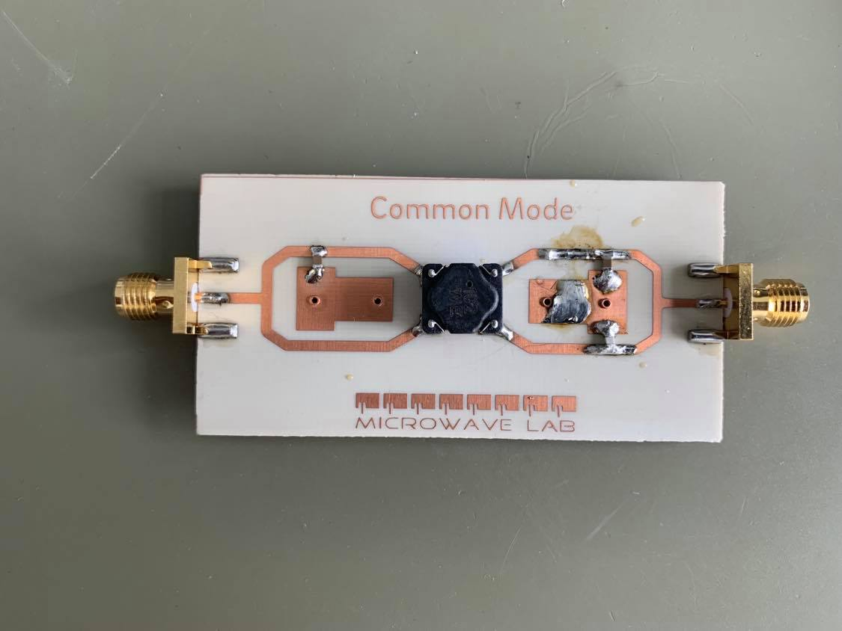
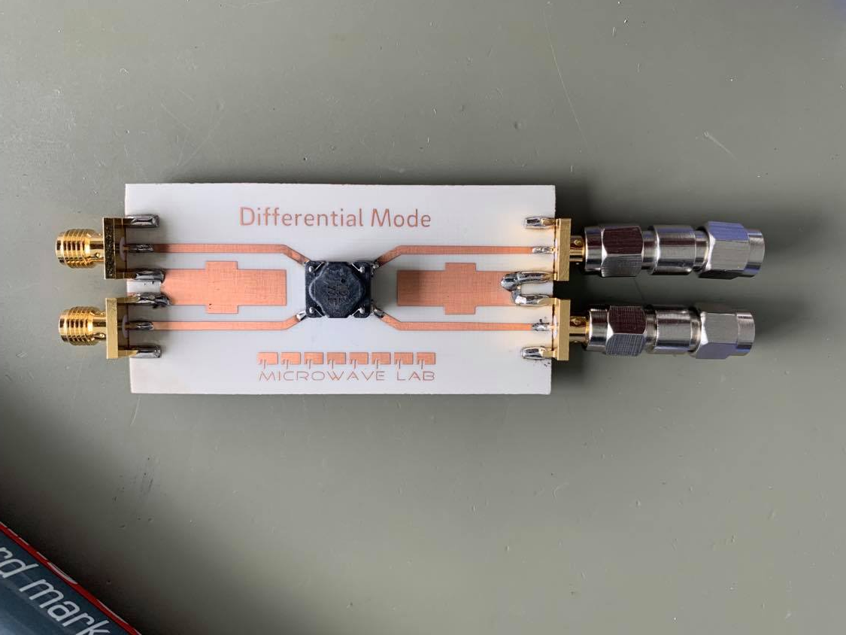
PCB Design of CM and dm filter

Slide 9
filter responses using multi tone sources
The time domain signal used in the Fourier series is periodic and continuous.
Periodic signals have a frequency spectrum consisting of harmonics.
If the time domain repeats at 10 Mhertz (a period of 1 microsecond), the frequency spectrum will contain a first harmonic at 10 Mhertz, a second harmonic at 20 Mhertz, a third harmonic at 30 Mhertz, and so forth.
Harmonics does not contribute to forming the time domain signal.
Frequency spectrum can be viewed in two ways:
(1) the frequency spectrum is continuous, but zero at all frequencies except the harmonics, or
(2) the frequency spectrum is discrete, and only defined at the harmonic frequencies.

Slide 10
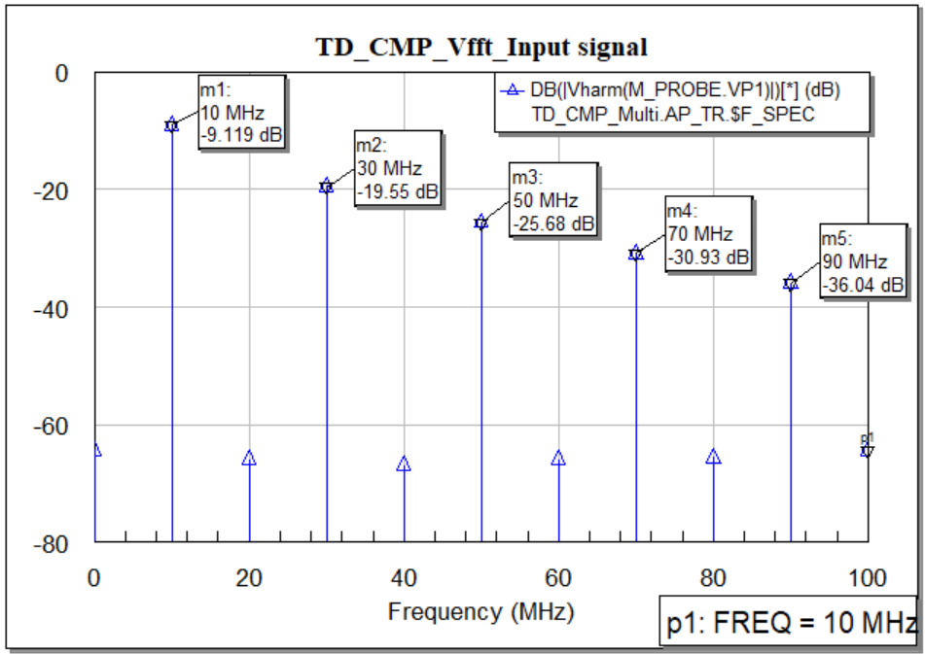
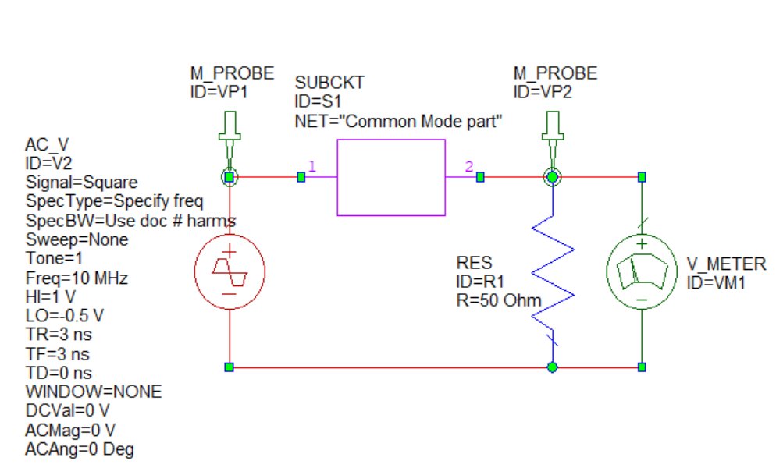
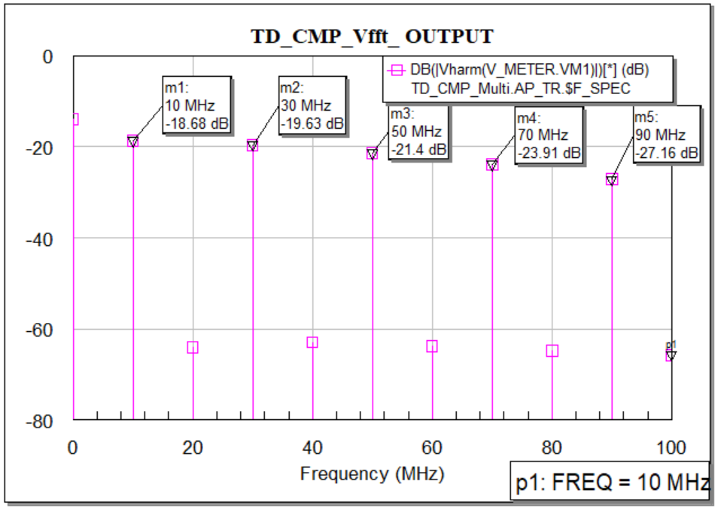
CM filter responses using multi tone sources

Slide 11
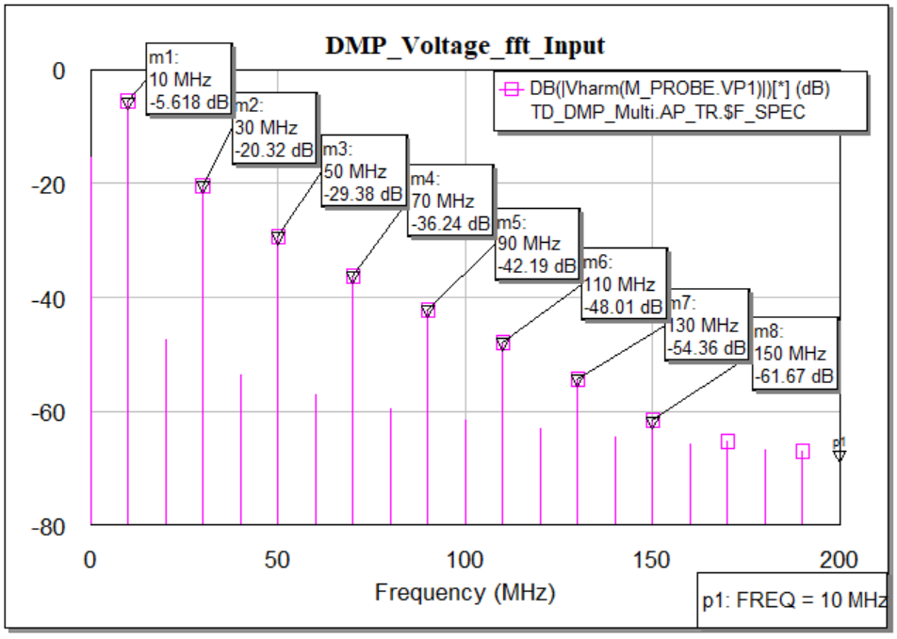
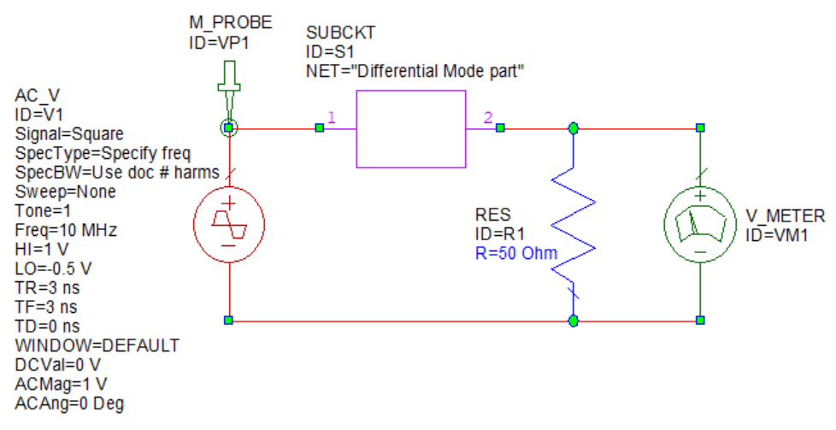
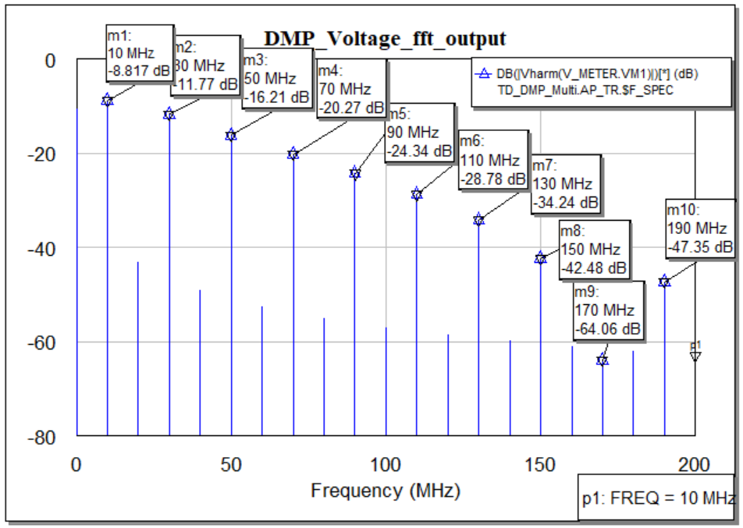
DM filter responses using multi tone sources

Slide 12
Generate noise source and simulate with filter
Hardware Part
As a noise source Comb generator is used.
Comb generator is producing multiple harmonies at 12, 36, 60, 84,……MHz
The amplitude is measured in mV and the power is measured as dBC.
Sofatware Part
In AWR only 5 tones were taken (AWR allows max 8 tones).
The noise source is calibrated in AWR with the designed filter and the result was observed.
At the above frequencies all the output frequencies behaves like stop band.

Slide 13
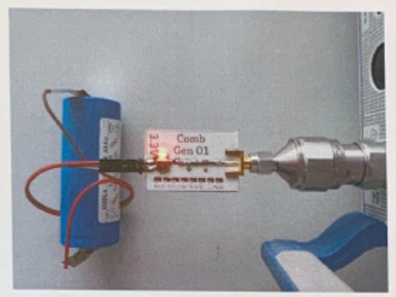
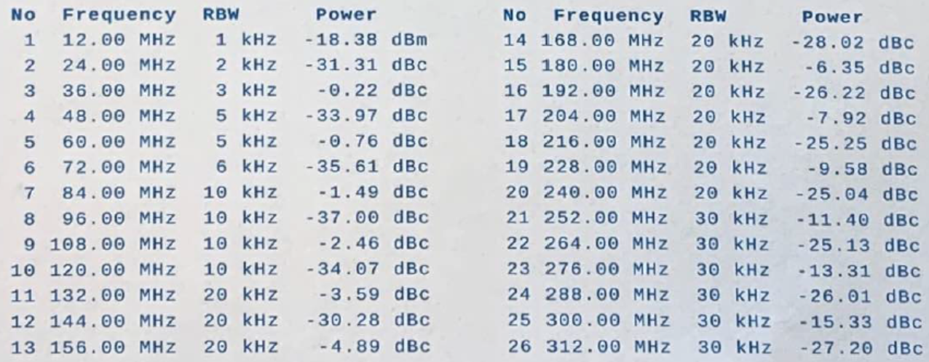
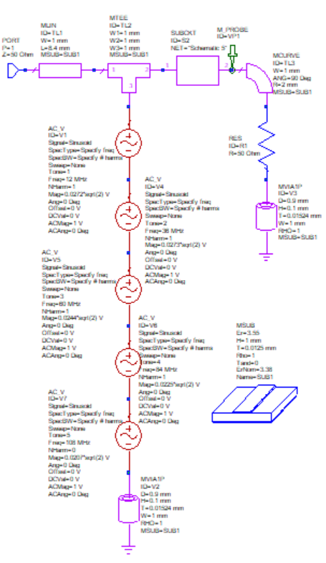
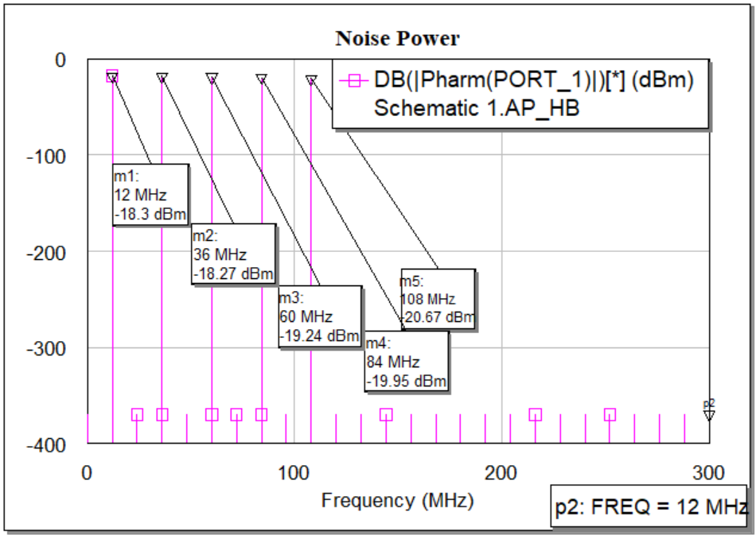
Generating noise sources

Slide 14
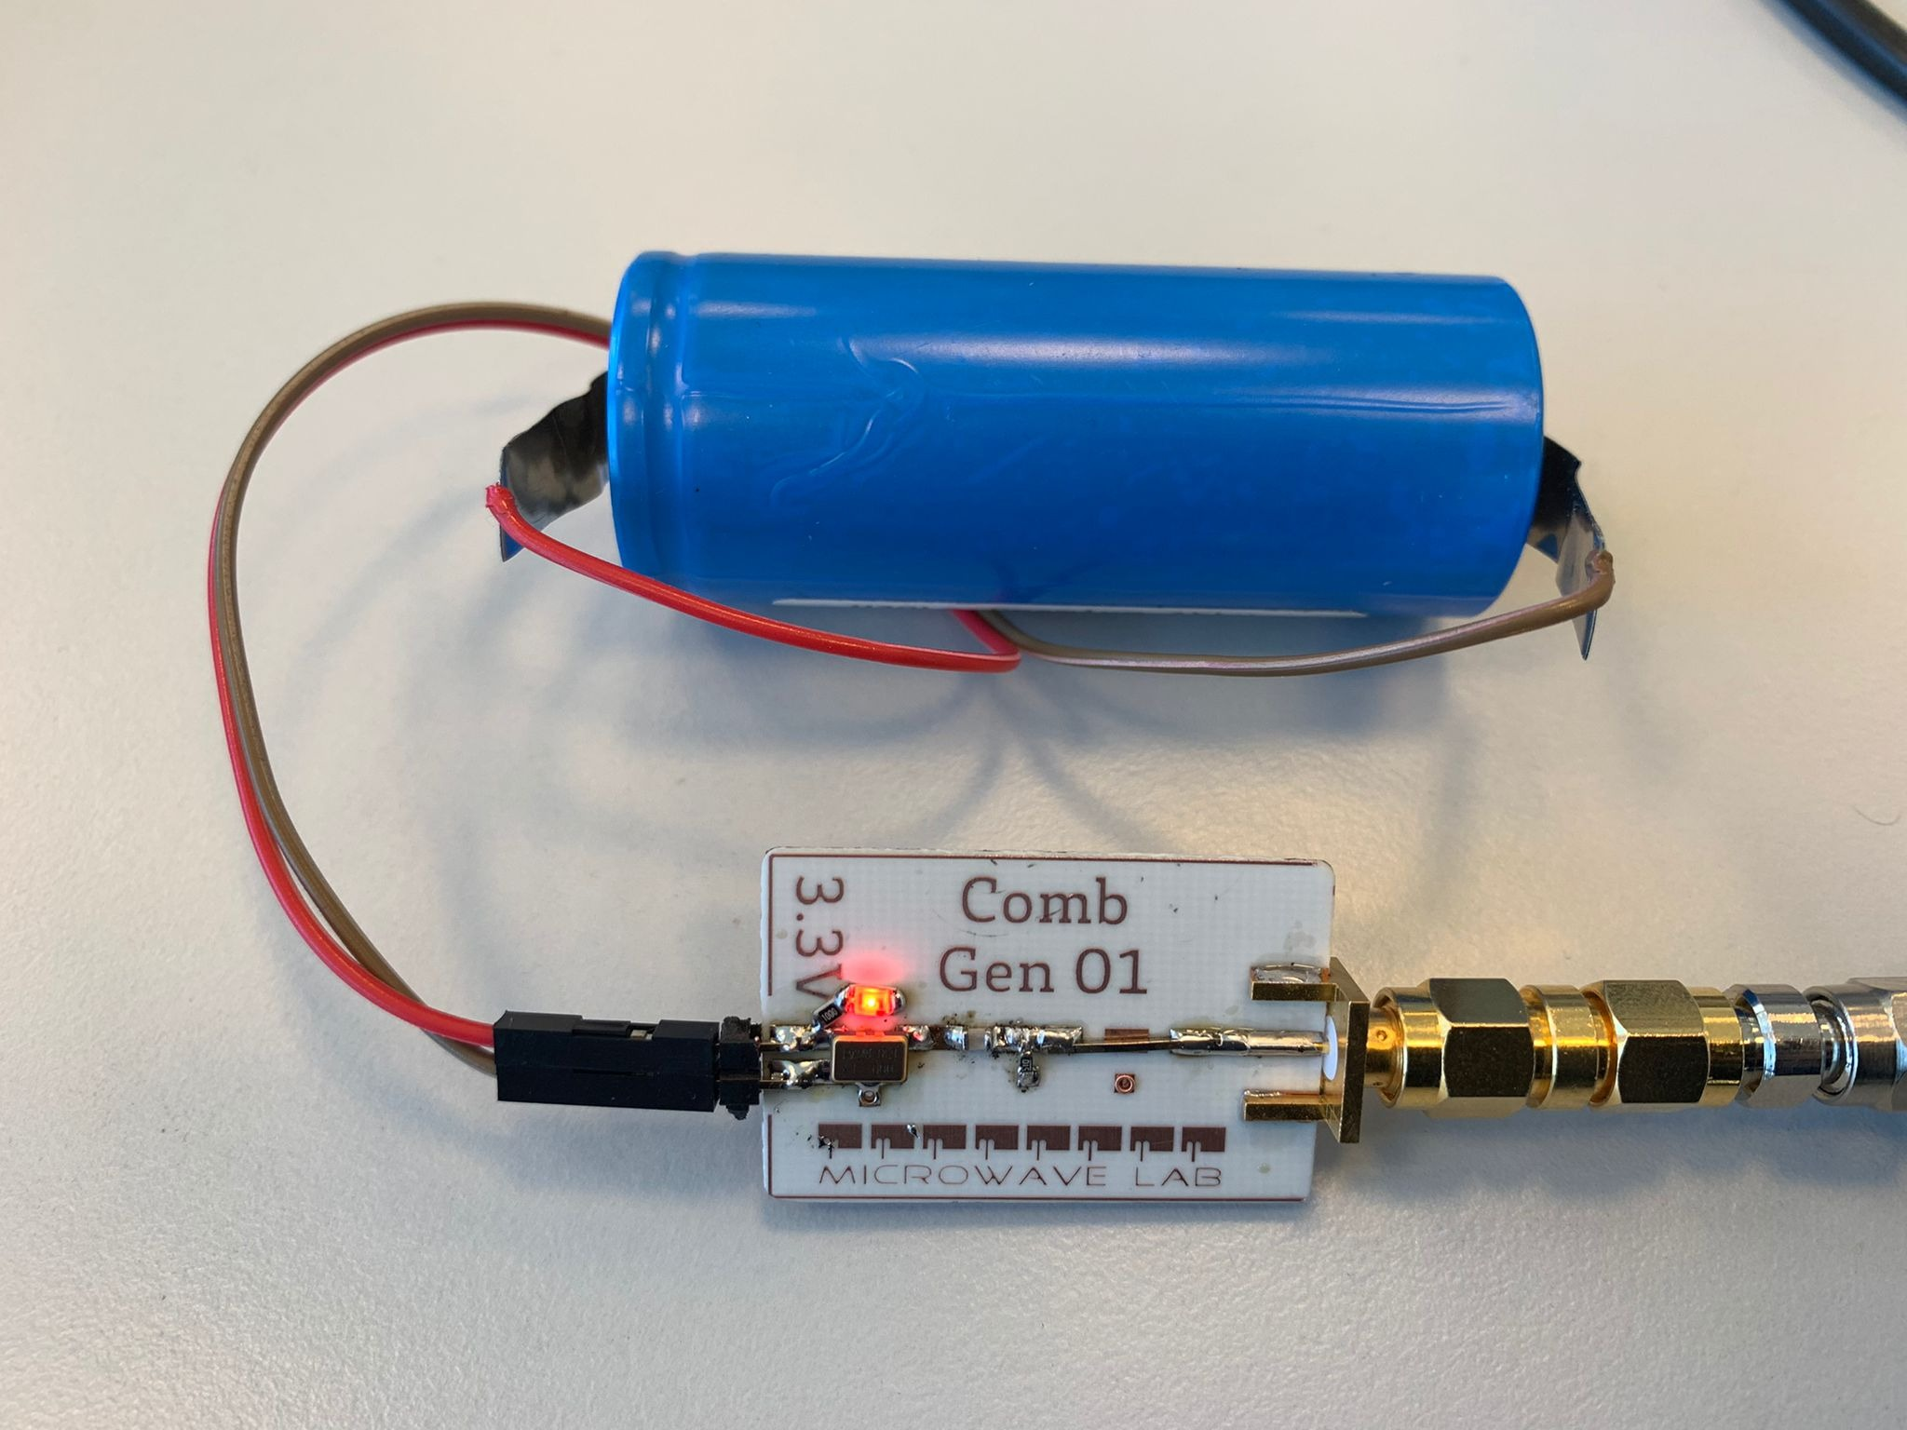
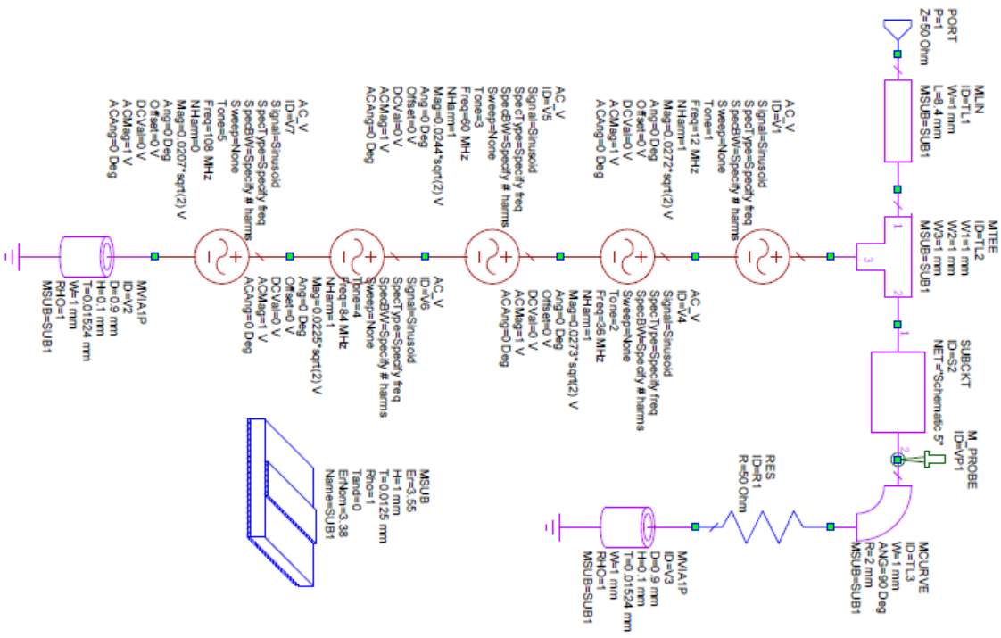
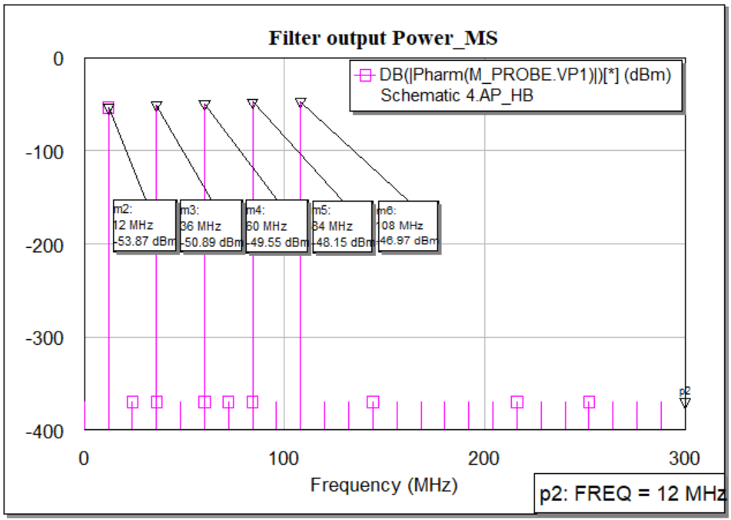
SIMULATING NOISE SOURCE WITH FILTER
Frequency (MHz) | Power (dBm)
12 | -48
36 | -49.4
60 | -47
84 | -47.3
108 | -41.3

